Slide 1
ARSITEKTUR SISTEM INFORMASI PERUSAHAAN
PERTEMUAN VII

Slide 2
Traditional Information System

Slide 3
Enterprise IS
Firm wide information systems that integrate key business processes so that information can flow freely between different parts of the firm.
Keywords:
Firm Wide IS, Integrated Business Process

Slide 4
Enterprise Information System

Slide 5
Sudut Pandang Enterprise
Keseluruhan organisasi sebagai sebuah sistem dan masing-masing departemen adalah subsitem.
Informasi tentang seluruh aspek organisasi disimpan dan dikelola secara terpusat dan dapat diakses oleh departemen lain yang membutuhkannya.
Transparansi informasi sehingga setiap departemen bisa mengetahui apa yang dikerjakan oleh departemen lain, dan bagaimana mendukung pekerjaan tersebut sehingga tujuan organisasi secara keseluruhan dapat dicapai.

Slide 6
Enterprise IS
Benefits
Firm structure and organization: One Organization
Management: Firm wide Knowledge-based Management Processes
Technology: Unified Platform
Business: More Efficient Operations and Customer-driven Business Processes
Challenges
Daunting Implementation
High Up-front Costs and Future Benefits
Inflexibility

Slide 7
Types of IS in Enterprise
Operational-level systems
support operational managers by monitoring the day-to-day’s elementary activities and transactions of the organization. e.g. TPS.
Knowledge-level systems
support knowledge and data workers in designing products, distributing information, and coping with paperwork in an organization. e.g. KWS, OAS
Management-level systems
support the monitoring, controlling, decision-making, and administrative activities of middle managers. e.g. MIS, DSS
Strategic-level systems
support long-range planning activities of senior management. e.g. ESS

Slide 8
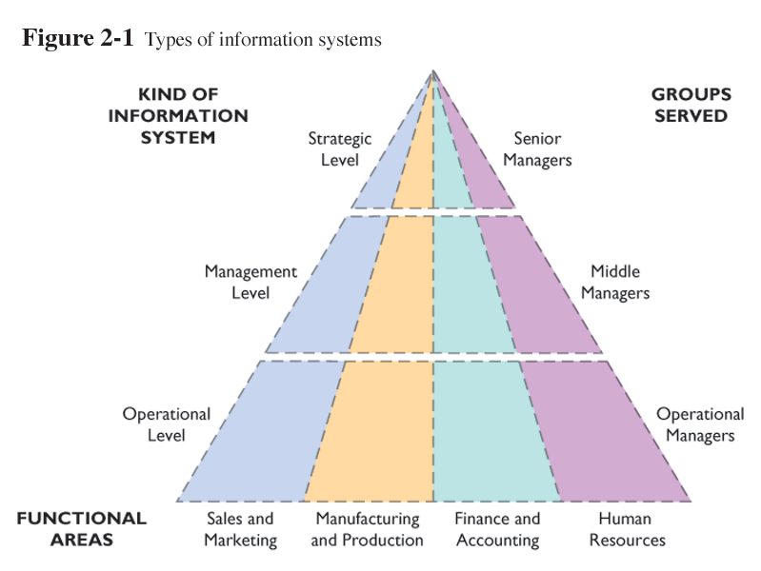
Types of IS

Slide 9
Relation Between Different IS
ESS
MIS
DSS
KWS/
OAS
TPS
TPS is a major producer of information for other systems

Slide 10
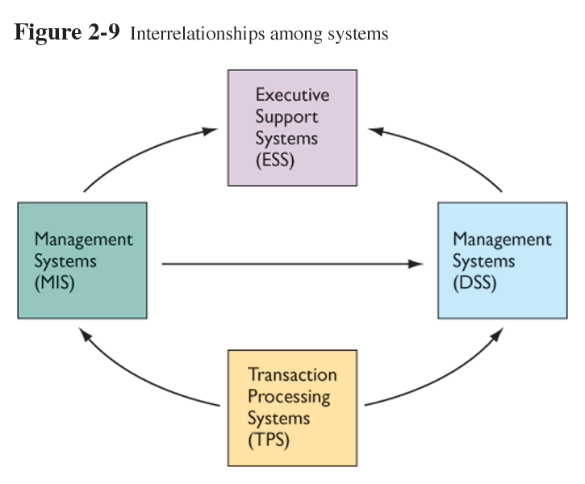
Interrelationships Among Systems
INTERRELATIONSHIPS:
These systems can share data and be interconnected
TPS generally feed all other systems
MIS generally indicate when a DSS is needed and provide input for them to crunch
- ESS take all internal data but usually only summary data from MIS and DSS level
Output data from one is input data for others to process

Slide 11
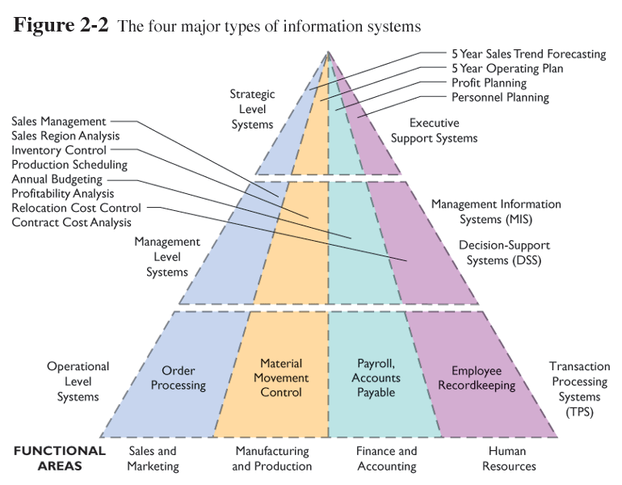
Major Types of IS

Slide 12
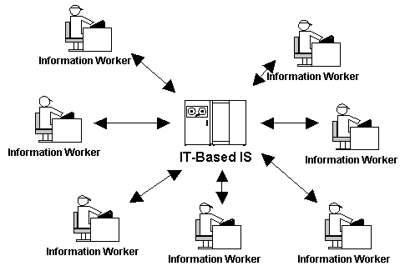
Components of EntIS
Hardware
Program Applications
Data
Procedures
People

